Slide 1

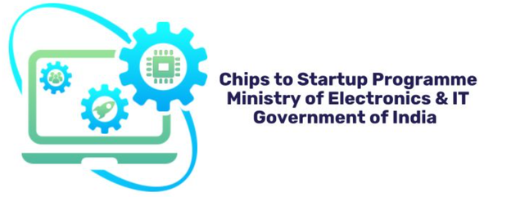

PRESENTED BY
TEAM IILX
THIRUMOORTHI.S
SIVAPRANESH.S.S
KARTHI KEYAN.S

Slide 2

BHARAT AI-SOC STUDENT CHALLENGE
LOCAL EDGE OPERATOR
https://github.com/Thirumoorthi-360

Slide 3



INTRODUCTION
This voice assistant that does not need the cloud would be very useful because the voice assistant would be able to do things without the cloud.
What if this thing could work all by itself without needing the internet on your computer? It would be totally secure and private. This thing could run entirely offline locally securely and privately on your hardware.
This project is about building a voice assistant that can work without the internet. We are making a voice assistant that runs on a Raspberry Pi 4. The Raspberry Pi 4 is a computer. We want to make sure this voice assistant uses little memory. We also want to keep the users information private. The Hindi voice assistant, on the Raspberry Pi 4 is what we are focusing on. We are trying to make this Hindi voice assistant work without using the internet at all.

Slide 4




ABSTRACT
This Hindi voice assistant can be activated with a wake word and it can do things for you without needing to connect to the internet. This means you can use the voice assistant anywhere even if you do not have internet.. Experimental results demonstrate low latency and stable performance on resource-limited hardware, making the system suitable for affordable edge AI applications

Slide 5


PROBLEM STATEMENT
Offline, Privacy-Preserving Hindi Voice Assistant on Raspberry Pi
OBJECTIVE
This project is about a voice assistant that works offline and keeps your information private. It is a voice assistant that runs on a Raspberry Pi 4 .What is different about this assistant is that it does all the work on the device itself so your data is safe. It responds quickly. The system use the limited memory of the Raspberry Pi 4 very efficiently.

Slide 6







TEXT TO SPEECH
DATABASE
AUDIO OUTPUT
MIND MAP
AUDIO INPUT
NATURAL LANGUAGE PROCESSING
SPEECH TO TEXT

Slide 7







TECH STACK
Python
Raspberry pi 4
VOSK
Raspberry pi
OS Lite
‘Bullseye ’
version
C++
INMP441 Mic (I2S)
e-speak
5 watts speaker

Slide 8

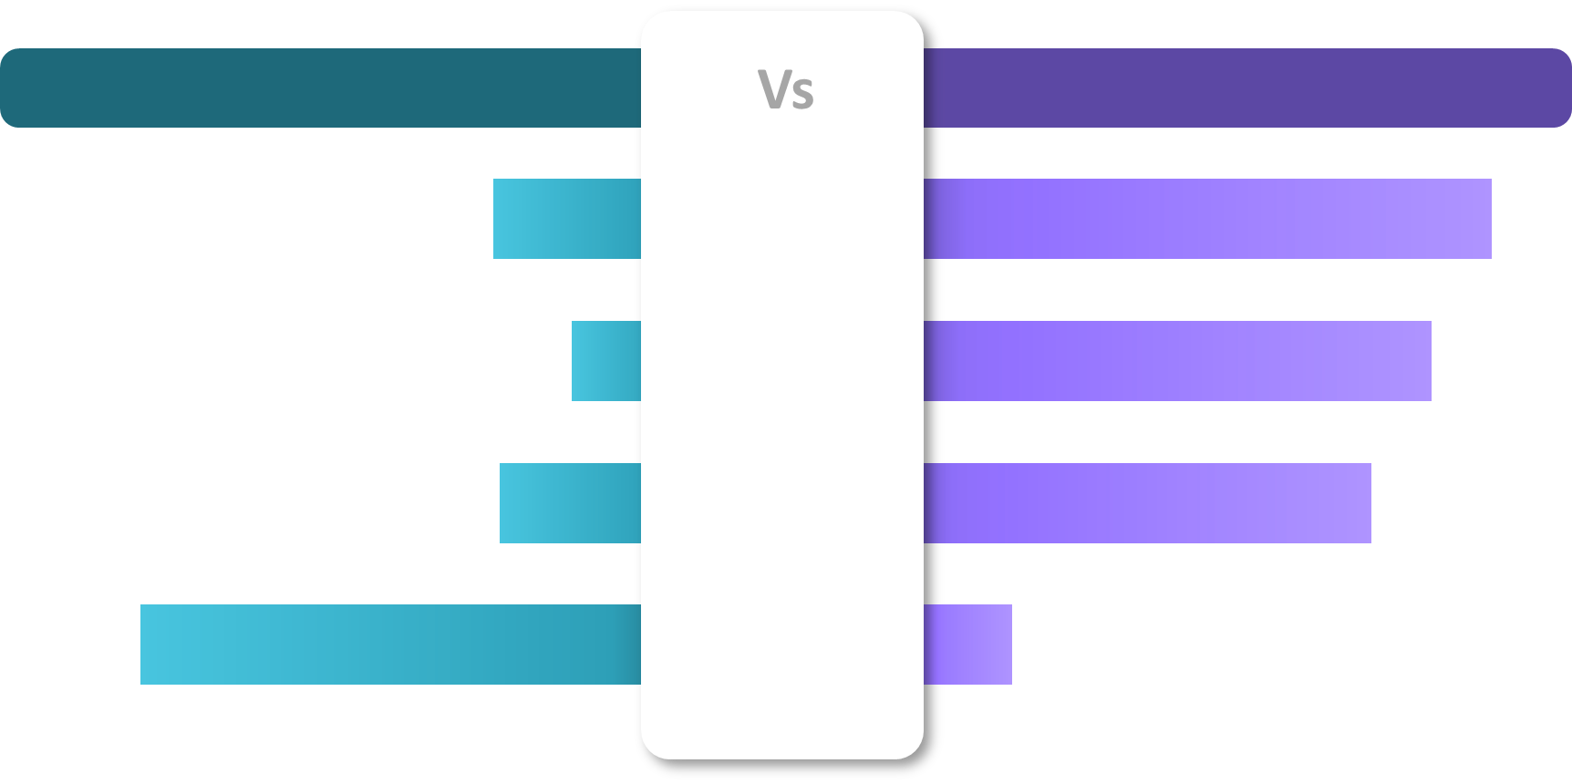
Competitional Mapping
C++ based edge-AI
Python based edge-AI
LATENCY
RAM USAGE
EXECUTION TIME
CODE
COMPLEXITY

Slide 9

CHALLENGES FACED
CHALLENGE NO. 1
Python-based AI models consume high memory
Large language models not feasible
Latency increases due to swapping
SOLUTION
Entire pipeline built in C++
Avoided dynamic STL heavy containers
CHALLENGE NO. 2
Mic output: 32-bit, 48kHz
Vosk requires: 16-bit, 16kHz
SOLUTION
Bit depth conversion (32-bit → 16-bit)
Downsampling (48kHz → 16kHz)

Slide 10
CHALLENGE NO. 3
Poor Hindi TTS Quality
Robotic pronunciation
Harsh consonants
High-frequency noise
SOLUTION
Low-pass filtering (~3–4 kHz cutoff)
Windowing techniques (Hamming window)
Amplitude normalization
DSP-based smoothing

Slide 11
Thank You
“ At the edge, every millisecond matters ”

